Slide 1
Face Expression Recognition via Measurable Features
Vasilis Gerontatis, BSc (Physics) MSc Student in Data Science and Machine Learning Module: DAMA 51

Slide 2
Problem Statement
The goal of this project is to analyse a dataset consisting of 210 instances from the Cohn-Kanade database, where each instance is represented by 25 facial measurements. These measurements capture key structural aspects of facial expressions, including eyebrow position, eye dimensions, mouth shape, and relationships between these components. The dataset is labelled with one of seven possible facial expressions: Neutral, Disgust, Sadness, Fear, Surprise, Anger, and Joy
What I Want to Accomplish
Feature Selection: Identify which facial measurements are the most critical for FER.
Evaluation Strategy: Define the best approach for training, testing, and validation.
Classification: Compare multiple machine learning classifiers to determine the most effective for FER.
Clustering: Analyse the dataset without labels and evaluate how well clustering methods can group expressions naturally.

Slide 3
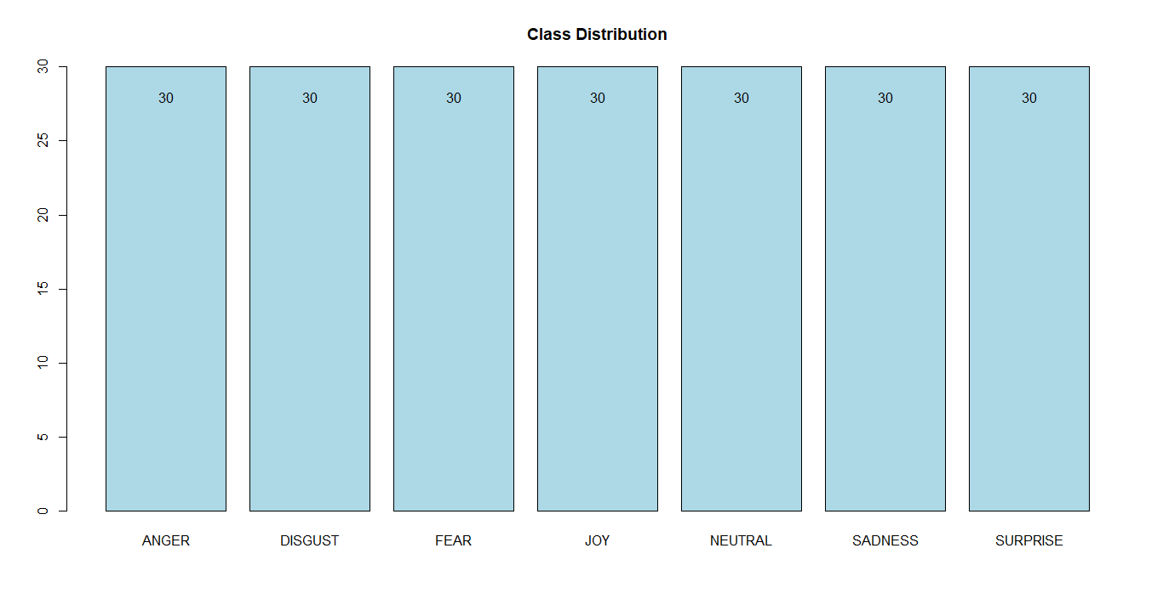
Exploring the Facial Expression Dataset
1. Check Class Distribution

Slide 4
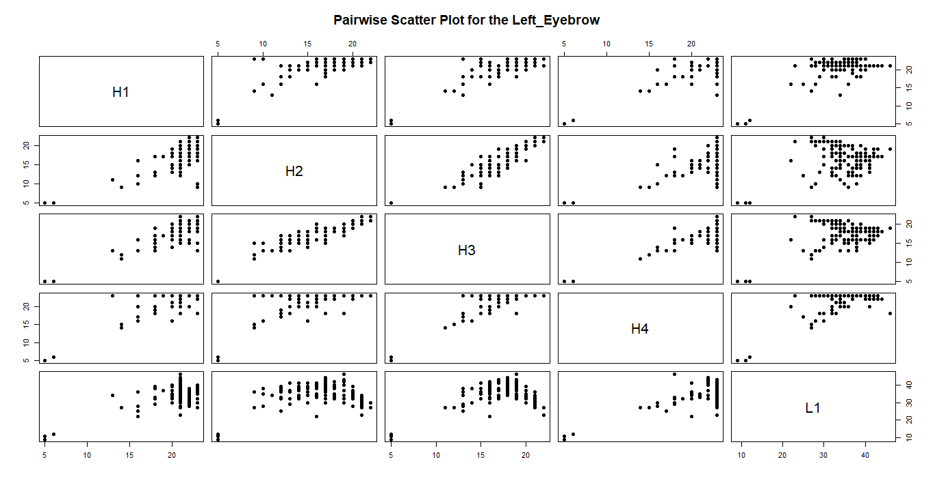
2. Check for Missing Values
3. Stratified train-test split (80%-20%) to maintain expression class distribution
4. Create pairwise scatter plots for feature groups

Slide 5
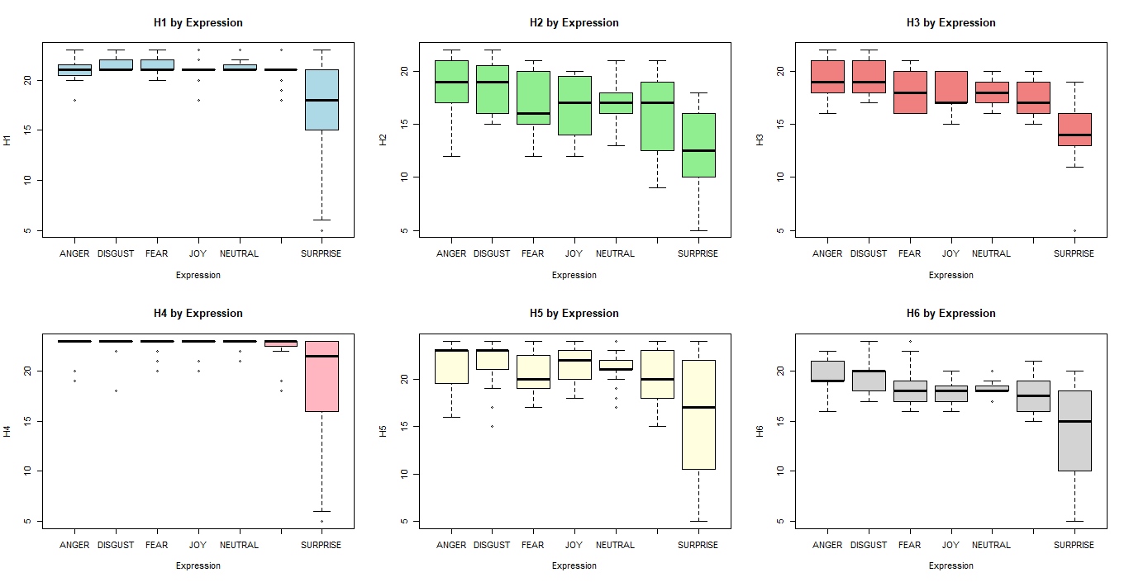
4. Plot boxplots of each feature grouped by Expression

Slide 6
Model Training & Evaluation
1. Evaluate three models: Naïve Bayes, Decision Tree, and K-Nearest Neighbours (KNN).
2. For each model, follow two distinct training paths within the cross-validation loops. Raw Features with Recursive Feature Elimination (RFE) and PCA-Transformed Features with RFE, to automatically select the best features
3. Naive Bayes (NB): Tune Laplace smoothing (fL), enable/disable kernel-based density estimation, and adjust smoothing bandwidth.
4. Decision Tree (DT): Select split decision metric, and optimize tree depth, minimum split size, and bucket size.
5. K-Nearest Neighbours (KNN): Tune k-value (kmax), distance metric (Manhattan vs. Euclidean), and kernel function for optimal performance.
6. Compare model performance with and without PCA

Slide 7
PCA appears to degrade model performance.
Naïve Bayes experiences a small decline in accuracy, dropping by 2.4%. This suggests that while PCA subtly violated the conditional independence assumption.
Decision Tree model's performance remains unchanged. This indicates that the principal components derived from the facial measurements neither improved nor harmed the model's ability to classify the data.
KNN is the most affected model, showing a significant 9.5% drop in accuracy. PCA, while preserving overall variance, can distort the local relationships between data points.
Model | Without PCA | With PCA | Change
Naïve Bayes | 61.9% | 59.5% | 🔻 -2.4%
Decision Tree | 38.1% | 38.1% | ⚫ 0.0%
KNN | 88.1% | 78.6% | 🔻 -9.5%

Slide 8
Naïve Bayes (NB) without PCA yielded the strongest outcomes for DISGUST, JOY, and NEUTRAL, though it faced challenges particularly with ANGER, FEAR, SADNESS, and SURPRISE. On the other hand, when PCA was applied, NB achieved top performance in FEAR, JOY, and SURPRISE, yet encountered more issues with ANGER, DISGUST, NEUTRAL and SADNESS.
Decision Tree (DT) prior to PCA showed the most effective results for JOY, and SURPRISE, but underperformed when it came to ANGER, DISGUST, FEAR, NEUTRAL, and SADNESS. After implementing PCA, DT handled JOY more successfully, but its accuracy dropped for ANGER, DISGUST, FEAR, NEUTRAL, SADNESS, and SURPRISE
K-Nearest Neighbours (KNN) before applying PCA managed ANGER, DISGUST, FEAR, JOY, NEUTRAL, SADNESS, and SURPRISE effectively, and had no struggles to classify accurately. Following PCA, KNN continued to do well on ANGER, DISGUST, FEAR, JOY, NEUTRAL, SADNESS, and SURPRISE, showing no weakness on performance.
K-Nearest Neighbours (KNN) appears to be the most effective and stable model, as it achieved the highest performance and classified expressions with the greatest accuracy.

Slide 9
Clustering:
1. Reduce dimensionality by applying PCA and keeping the top components explaining ~80% of the variance
2. Apply and evaluate three clustering algorithms: K-Means, Gaussian Mixture Model (GMM), DBSCAN.
3. K-Means: Tune k.
4. Gaussian Mixture Model (GMM): Tune k.
5. DBSCAN: Tune eps and minPts values.

Slide 10
K-Means: With a silhouette score of approximately 0.298, K-Means shows a moderate level of cluster separation. Its Adjusted Rand Index (ARI) of around 0.076 indicates a weak alignment with the true classes. This suggests that while K-Means found moderately distinct clusters, they don't strongly correspond to the real-world categories of your data
GMM: The Gaussian Mixture Model's silhouette score of about 0.150 shows a poor level of cluster separation and is the lowest of the three models. Its ARI of approximately 0.064 confirms a very weak correspondence with the true classes, performing the worst in this regard
DBSCAN: DBSCAN performed the best in terms of cluster separation, with the highest silhouette score of approximately 0.543. This score indicates that the clusters it formed were well-separated. However, its ARI of around 0.062 shows that despite finding well-defined clusters, they had the weakest alignment with the true classes, performing slightly worse than GMM in this aspect
Clustering algorithms struggle to distinguish facial expressions due to overlapping feature patterns and subtle differences between emotions, leading to mixed cluster compositions. This suggests unsupervised methods alone are insufficient for clearly separating all seven expressions.

